Slide 1
Conditional Control: Statements
Chapter 4

Slide 2
Objectives
This lesson covers the following objectives:
Describe a use for conditional control structures
List the types of conditional control structures
Construct and use an IF statement
Construct and use an IF-THEN-ELSE statement
Create PL/SQL to handle the null condition in IF statements
Construct and use a Basic Loop
Construct and use a For loop
Construct and use While loop

Slide 3
Controlling the Flow of Execution
You can change the logical flow of statements within the PL/SQL block with a number of control structures
This lesson introduces three types of PL/SQL control structures: Conditional constructs with the
IF statement
CASE expressions
LOOP control structures

Slide 4
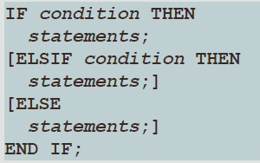
IF Statement
The structure of the PL/SQL IF statement is similar to the structure of IF statements in other procedural languages
It enables PL/SQL to perform actions selectively based on conditions
Syntax:

Slide 5
IF Statements Note
ELSIF and ELSE are optional in an IF statement
You can have any number of ELSIF keywords but only one ELSE keyword in your IF statement
END IF marks the end of an IF statement and must be terminated by a semicolon
SQL%FOUND, SQL%NOTFOUND, and SQL%ROWCOUNT are PL/SQL attributes that can be used to determine the effect of an SQL statement.
The SQL%FOUND attribute has a Boolean value that returns TRUE if at least one row was affected by an INSERT, UPDATE, or DELETE statement, or if a SELECT INTO statement retrieved one row.

Slide 6
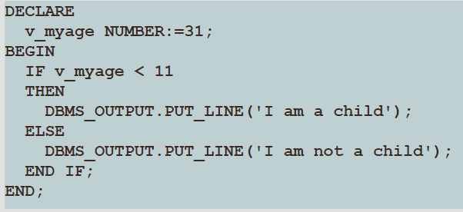
Simple IF Statement
This is an example of a simple IF statement with a THEN clause
The v_myage variable is initialized to 31

Slide 7
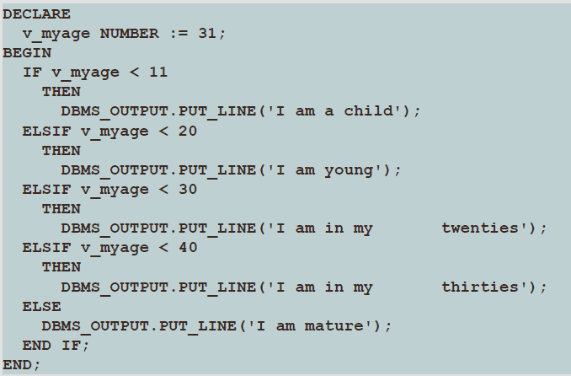
IF ELSIF ELSE Clause
The IF statement now contains multiple ELSIF clauses as well as an ELSE clause
Notice that the ELSIF clauses add additional conditions

Slide 8
IF Statement with Multiple Expressions
An IF statement can have multiple conditional expressions related with logical operators, such as AND, OR, and NOT
This example uses the AND operator
Therefore, it evaluates to TRUE only if BOTH the first name and age conditions are evaluated as TRUE
There is no limitation on the number of conditional expressions that can be used
However, these statements must be connected with the appropriate logical operators

Slide 9
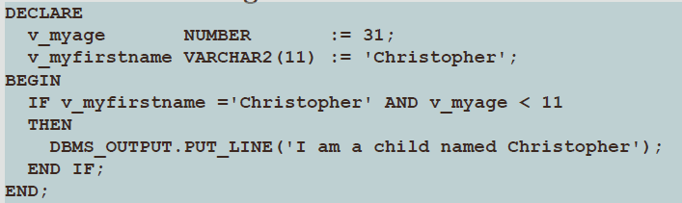
IF Statement with Multiple Expressions

Slide 10
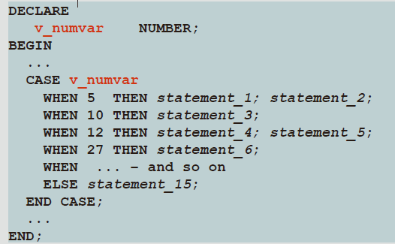
Using a CASE Statement

Slide 11
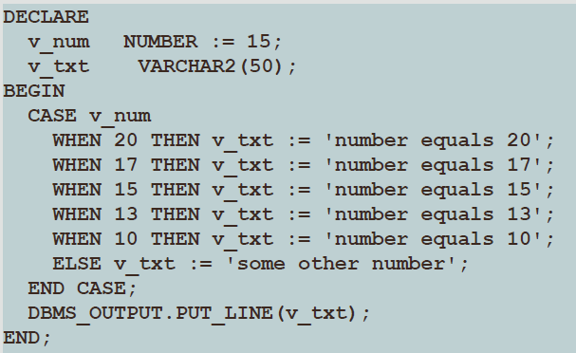
CASE Statements: An Example

Slide 12
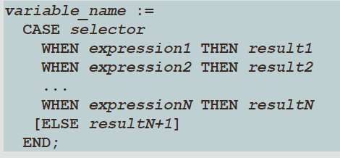
CASE Expression Syntax
A CASE expression is different from a CASE statement because it selects one of a number of results and assigns it to a variable
A CASE expression ends with END not END CASE
In the syntax, expression can be a literal value or an expression such as (v_other_var* 2)

Slide 13
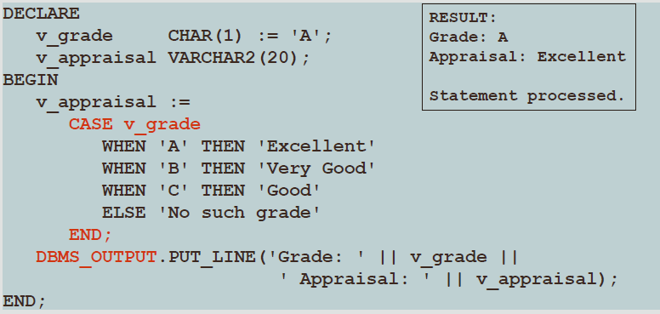
CASE Expression Example
What would be the result of this code if v_grade was initialized as "C" instead of "A"

Slide 14
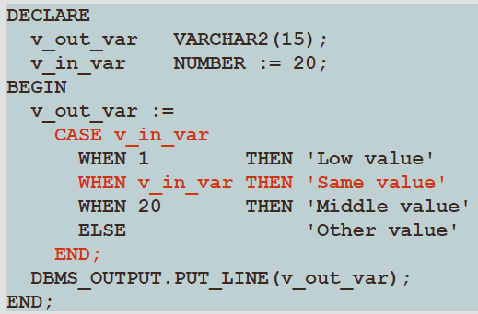
CASE Expression: A Second Example
Determine what will be displayed when this block is executed:

Slide 15
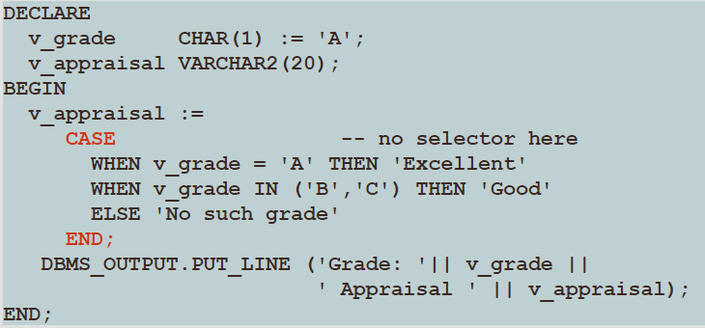
Searched CASE Expressions: An Example
Searched CASE expressions allow non-equality conditions, compound conditions, and different variables to be used in different WHEN clauses

Slide 16
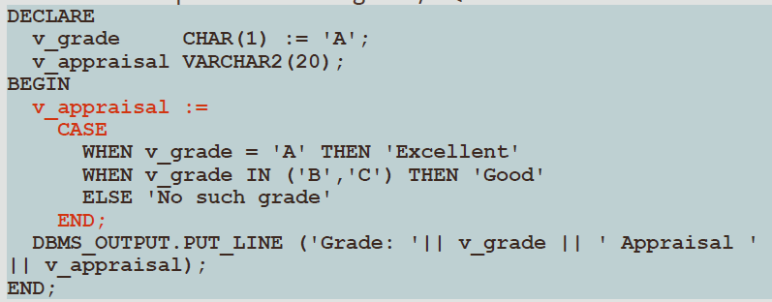
How are CASE Expressions Different From CASE Statements?
They are different because: CASE expressions return a value into a variable
CASE expressions end with END;
A CASE expression is a single PL/SQL statement

Slide 17
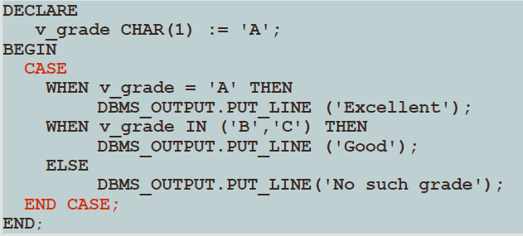
How are CASE Expressions Different From CASE Statements?
CASE statements evaluate conditions and perform actions
A CASE statement can contain many PL/SQL statements
CASE statements end with END CASE;

Slide 18
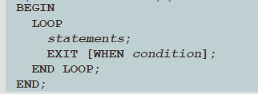
Basic Loops
The simplest form of a LOOP statement is the basic loop, which encloses a sequence of statements between the keywords LOOP and END LOOP
Use the basic loop when the statements inside the loop must execute at least once
Each time the flow of execution reaches the END LOOP statement, control is passed to the corresponding LOOP statement that introduced it
A basic loop allows the execution of its statements at least once, even if the EXIT condition is already met upon entering the loop
Without the EXIT statement, the loop would never end (an infinite loop)

Slide 19
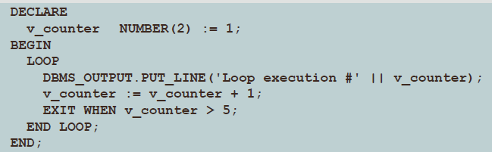
Basic Loops Simple Example
In this example, no data is processed
We simply display the loop counter each time we repeat the loop

Slide 20
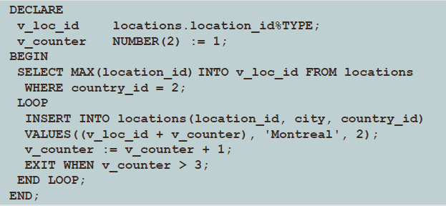
Basic Loops More Complex Example
In this example, three new location IDs for Montreal, Canada, are inserted in the LOCATIONS table

Slide 21
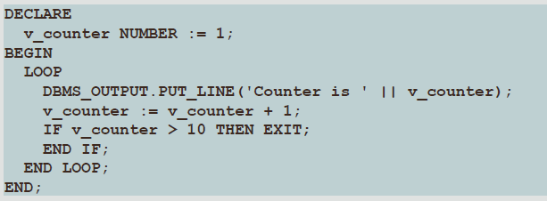
Basic Loops EXIT Statement
You can use the EXIT statement to terminate a loop and pass control to the next statement after the END LOOP statement
You can issue EXIT as an action within an IF statement

Slide 22
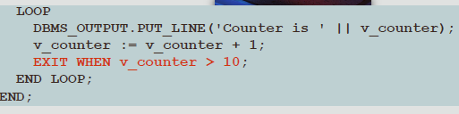
Basic Loop EXIT Statement Rules
Rules:
The EXIT statement must be placed inside a loop
If the EXIT condition is placed at the top of the loop (before any of the other executable statements) and that condition is initially true, then the loop exits and the other statements in the loop never execute
A basic loop can contain multiple EXIT statements

Slide 23
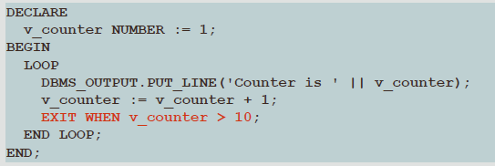
Basic Loop EXIT WHEN Statement
Although the IF…THEN EXIT works to end a loop, the correct way to end a basic loop is with the EXIT WHEN statement
If the WHEN clause evaluates to TRUE, the loop ends and control passes to the next statement following END LOOP

Slide 24
WHILE Loops
You can use the WHILE loop to repeat a sequence of statements until the controlling condition is no longer TRUE
The condition is evaluated at the start of each iteration
The loop terminates when the condition is FALSE or NULL
If the condition is FALSE or NULL at the initial execution of the loop, then no iterations are performed

Slide 25
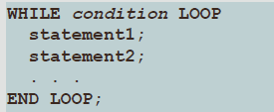
WHILE Loops Syntax
In the Syntax
Condition is a Boolean variable or expression (TRUE, FALSE, or NULL)
Statement can be one or more PL/SQL or SQL statements

Slide 26
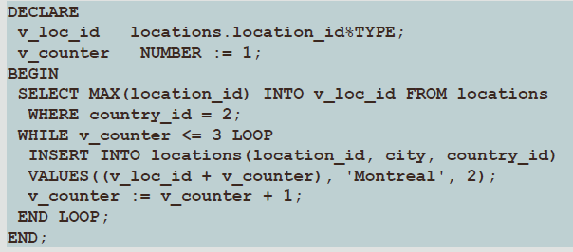
WHILE Loops Example
With each iteration through the WHILE loop, a counter (v_counter) is incremented
If the number of iterations is less than or equal to the number 3, then the code within the loop is executed and a row is inserted into the locations table

Slide 27
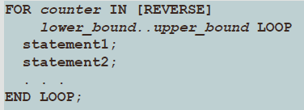
FOR Loops Described
FOR loops have the same general structure as the basic loop
In addition, they have a control statement before the LOOP keyword to set the number of iterations that PL/SQL performs
FOR loop rules: Use a FOR loop to shortcut the test for the number of iterations
Do not declare the counter; it is declared implicitly lower_bound.. Upper_bound is the required syntax

Slide 28
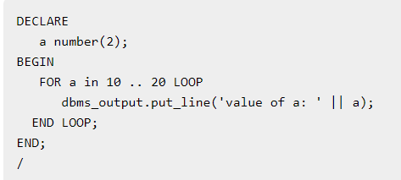
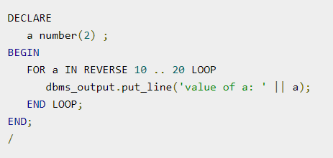
FOR Loop Example

Slide 29
Questions
1. Using the CASE expression, write a PL/SQL block to display First_Name, Staff_Type from the F_STAFFS table for a given ID. Based on the following:
If the number of digits of ID is 1, display Old
If the number of digits of ID is 2, display Young
If the number of digits of ID is 3, display New
Otherwise, display Not Exist

Slide 30
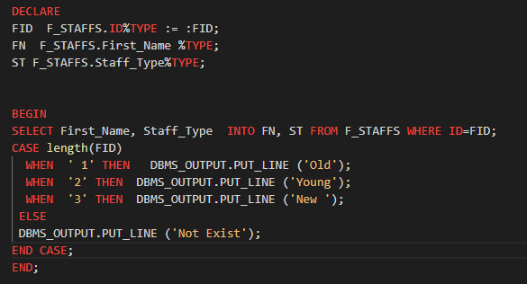

Slide 31
2. Using Basic Loop write a PL/SQL Block to print a sequences number from 10 to 50, exit when 60 then display (After Exit is : 60)?
3. Using D_EVENTS table write IF Statement in the PL/SQL Block to update the table and increase the Cost of each Events by 100 and use the SQL%ROWCOUNT attribute to determine the number of rows affected.
4. Using FOR LOOP write a PL/SQL Block to print a sequences number starting from 10, increment the value by 1, exit when 20

Slide 32
